Slide 1











DesertDinoDash
Presented by Group3 - INNOVA

Slide 2
Our Team
ANSARI BUSHRA ZAHIRUDDIN
SRIVASTAVA SAGARIKA SHEKHAR
SHAIKH SIDRA AMJAD ALI
SOLKAR SIDRA SAMEER

Slide 3
Introduction
The mobile gaming industry has experienced exponential growth over the past decade, with casual games emerging as a dominant genre. Casual games are characterized by their simple mechanics, accessibility, and ability to engage a broad audience. Among the popular sub-genres of casual games, endless runner games—where players guide a character through a continuously progressing environment while avoiding obstacles—have gained widespread appeal due to their easy-to-learn yet challenging nature. DesertDinoDash, the focus of this investigation, belongs to this genre and aims to offer a dynamic and engaging experience by guiding a dinosaur through a perilous desert landscape filled with obstacles

Slide 4
Problems
A dynamic difficulty scaling mechanism was implemented to maintain player engagement by adjusting the game's difficulty in real-time. This was achieved by increasing the dinosaur’s speed and reducing the space between obstacles as the player progressed.
1
2
While the procedural generation algorithms worked effectively for obstacle placement and terrain variation, more sophisticated terrain design could be explored in the future to add more variety and complexity to the desert environment.

Slide 5
Goals
1
Expanding the game world beyond the desert setting by introducing new biomes (e.g., forest, volcanic areas) with unique obstacles and terrain could add more variety and visual interest.
2
To generate revenue, in-game advertisements or in-app purchases could be implemented, offering players cosmetic upgrades or additional content, such as new dinosaur skins or special environments. Care should be taken to ensure that monetization does not disrupt the player experience.

Slide 6
Result
The investigation into the development and implementation of DesertDinoDash has yielded valuable insights into the creation of a dynamic and engaging casual game, incorporating elements of procedural generation, difficulty scaling, and optimized player interaction. This investigation's primary goal was to design a game that maintained high replay ability while providing a straightforward yet enjoyable experience for players

Slide 7
Conclusion
In conclusion, the present investigation successfully demonstrated the feasibility of developing a casual endless runner game that blends engaging gameplay with procedural content generation and difficulty scaling. The methodologies and techniques adopted provided the basis for a game that is both accessible and challenging, with the potential for future expansions and improvements. Through iterative development and refinement, DesertDinoDash is well-positioned to capture the interest of its target audience and achieve long-term success in the competitive casual gaming market.

Slide 8
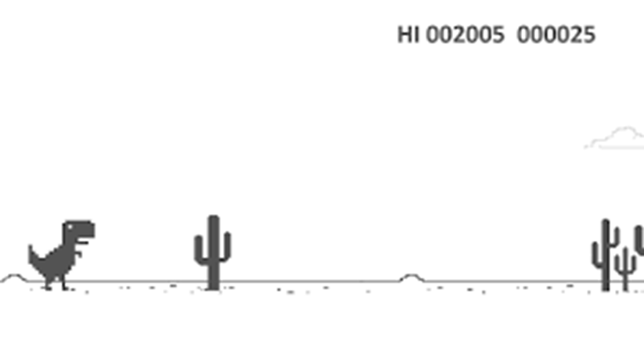
Related Photos

Slide 9
Q&A
Time

Slide 10
Thank
You
Group 3 - INNOVA

